Slide 1
COLOR BALANCE AND FUSION FOR UNDERWATER IMAGE ENHANCEMENT
GUIDE: M.V.BHUJANGA RAO
TEAM:
S.MANASA
P.SAI HARISH
P.MOUNICA
M.N.S.TEJA

Slide 2
PROBLEM STATEMENT
Underwater images are of poor quality and are blurred . To reduce the blurriness of the image and to enhance the quality of underwater images through image enhancement techniques.

Slide 3
EXISTING METHODS
Histogram Equalization
Histogram Equalization is a method in image processing of contrast adjustment using the image’s histogram.
Gamma Correction
Gamma Correction adjust the contrast of the image and thus enhances the image.

Slide 4
PROBLEMS IN EXISTING SOLUTION
HISTOGRAM EQUALIZATION
Advantages-
Offers an excellent enhancement of image contrast.
Easy to implement.
Disadvantages-
Computationally very slow
Requires high number of operations per pixel

Slide 5
PROBLEMS IN EXISTING SOLUTIONS
GAMMA CORRECTION-
Advantages-
Gamma Correction maps luminance levels to compensate the non-linear luminance effect of displayed images.
Disadvantages-
Most Gamma Correction images have limited precision , and hence multiple input pixel values may map to same output.

Slide 6
PROPOSED SOLUTION
The proposed solution introduces a novel approach to remove the haze in underwater images based on a single image captured with a conventional camera.
Our approach builds on the fusion of multiple inputs but derives the inputs to combine by correcting the contrast and the sharpening a white-balanced version of a single native input image.

Slide 7
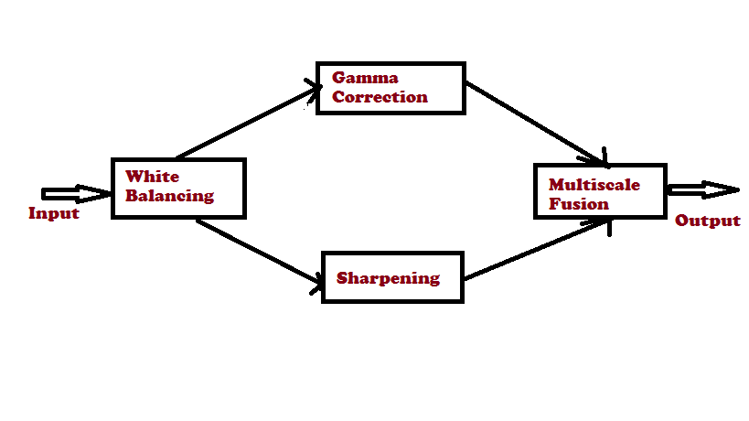
ARCHITECTURE

Slide 8
White balancing
White Balancing = Color Balancing + Color Temperature
White Balancing is performed in two steps
Step 1 : Loss of Red Channel
Step 2: Adoption of Gray World Algorithm
Irc(x) = Ir (x) + α.(I¯g − I¯r ).(1−Ir(x)).Ig(x),

Slide 9
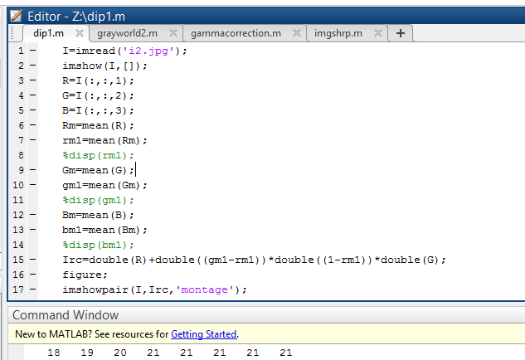
Loss of red channel

Slide 10
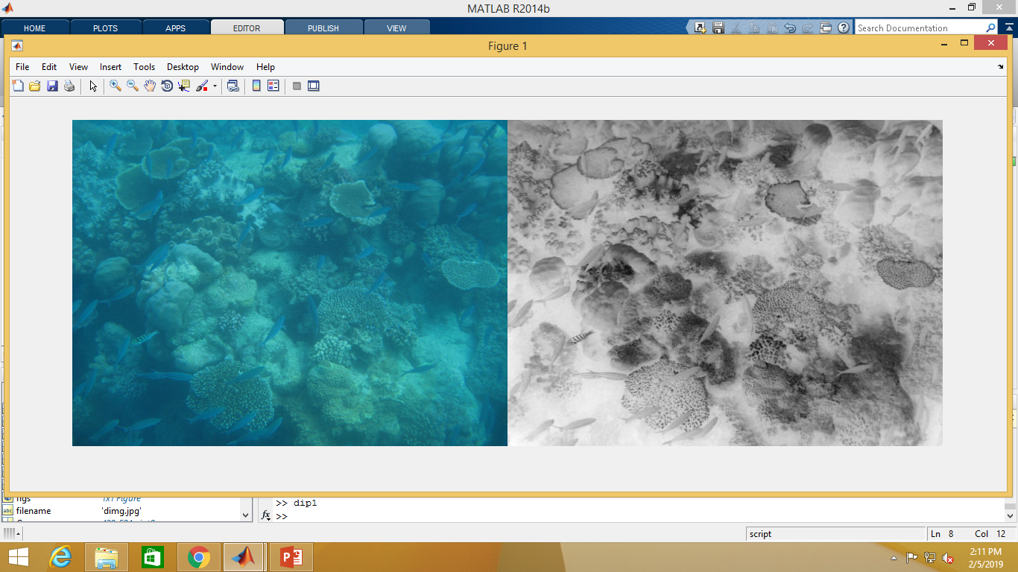
Output-

Slide 11
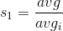
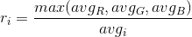
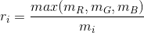
Gray world algorithm

Slide 12
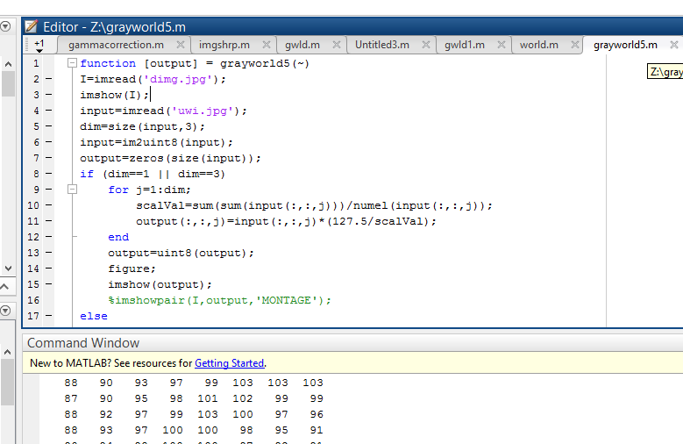
Gray world algorithm

Slide 13
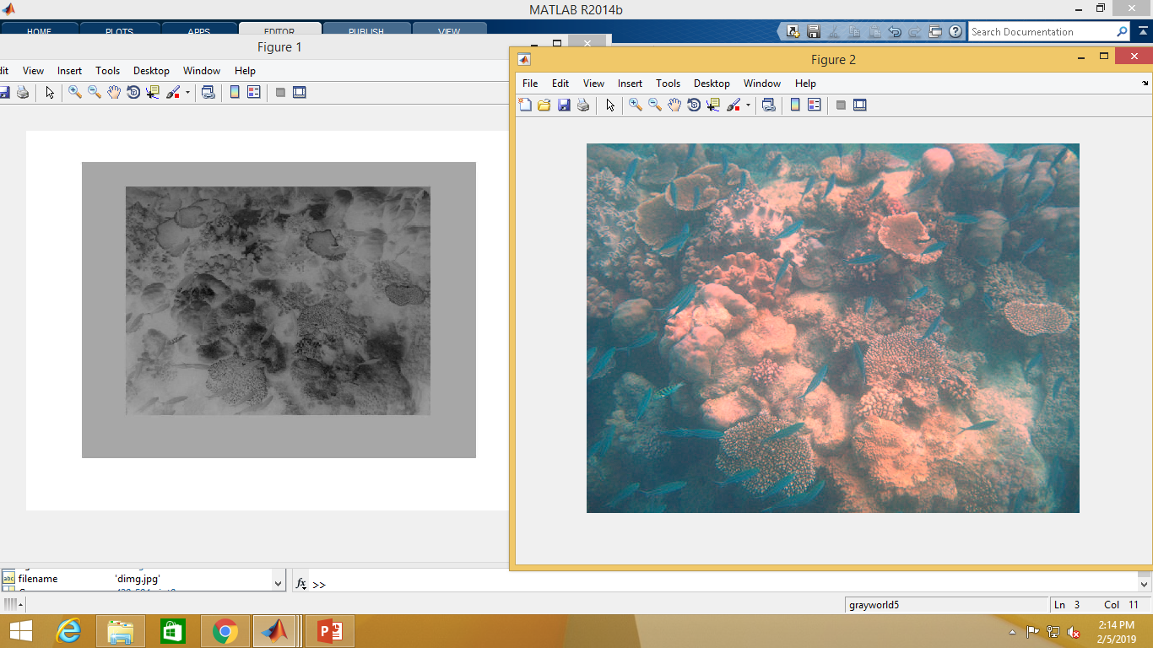
output

Slide 14
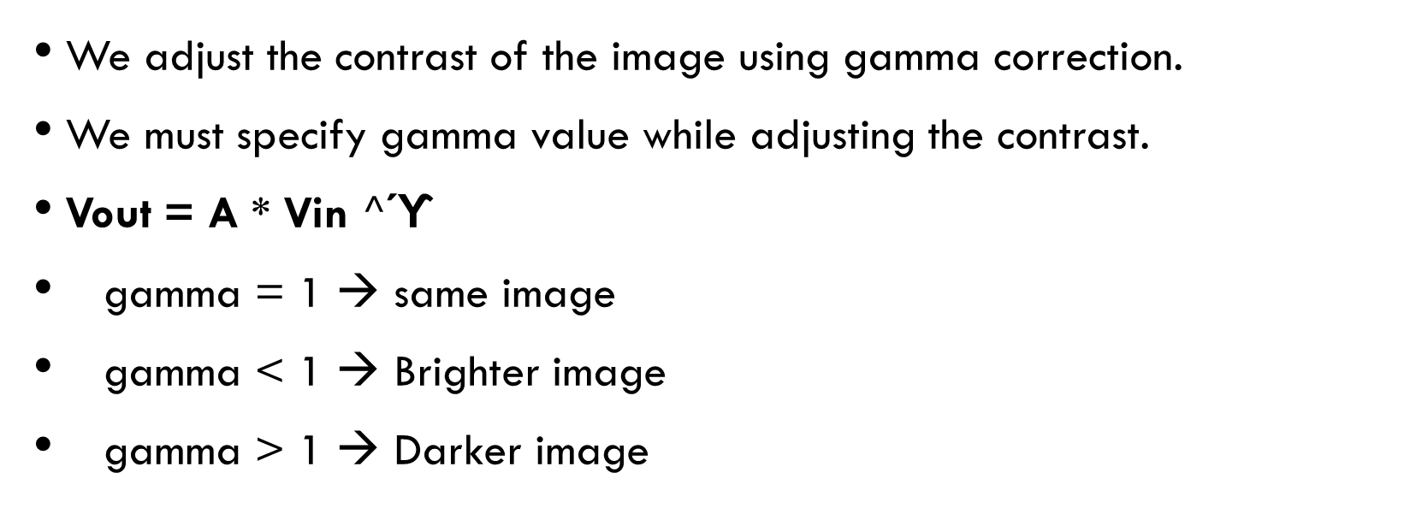
Gamma correction
We adjust the contrast of the image using gamma correction.
We must specify gamma value while adjusting the contrast.
Vout = A * Vin $^$ϓ
gamma = 1 → same image
gamma < 1 → Brighter image
gamma > 1 → Darker image

Slide 15
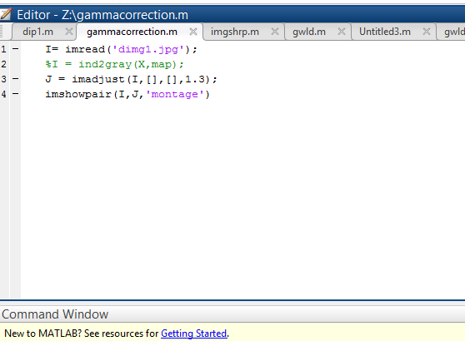
Gamma Correction

Slide 16
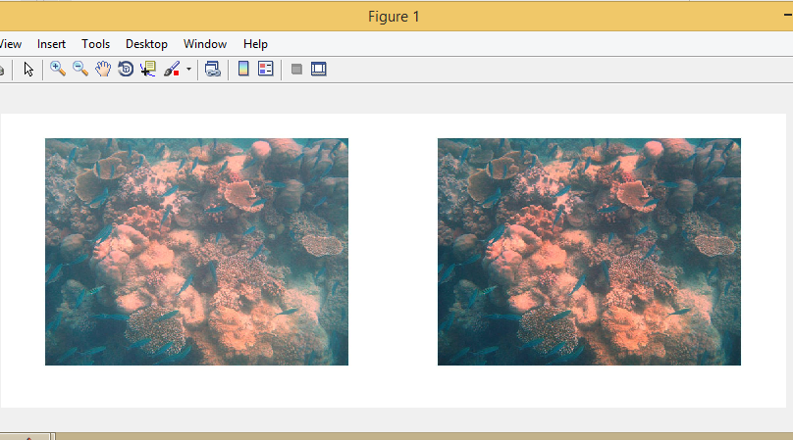
output

Slide 17
Image sharpening
Enhances the edges and fine details in an image
We specify Name Value pair arguments for fine sharpening of an image

Slide 18
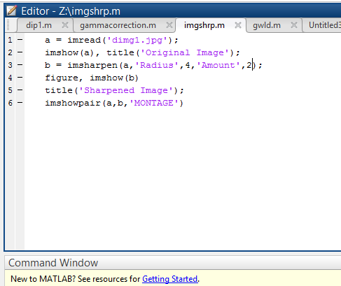
Image sharpening

Slide 19
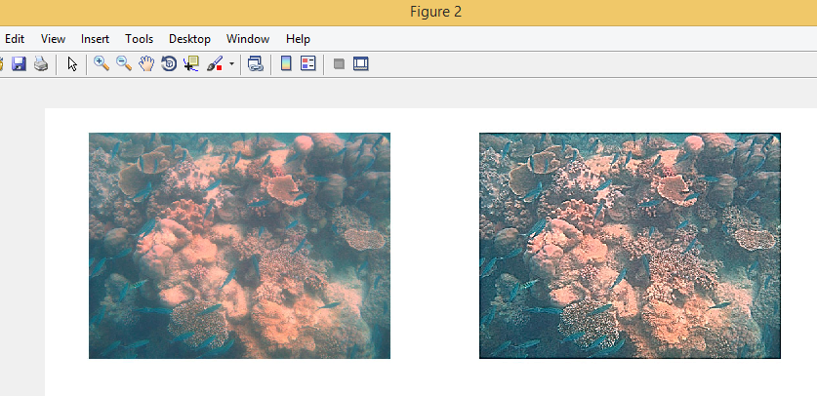
output

Slide 20
Multiscale fusion
Multi Scale Fusion extracts all the features from various images and gathers them into a single image.
Rl(x) = sigma( K k=1 Gl W¯ k (x) Ll {Ik (x)})

Slide 21
OVERVIEW

Slide 22
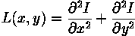
Laplacian contrast weight
It estimates global contrast by computing the absolute value of a laplacian filter applied on each input.

Slide 23
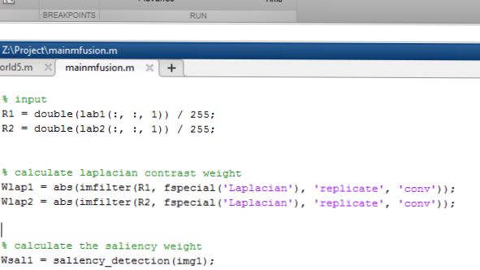
LAPLACIAN CONTRAST WEIGHT

Slide 24
SALIENCY WEIGHT
It aims at emphasizing the salient objects that lose their prominence in underwater scenes.
Saliency weight helps in showing each pixel’s unique quality in an image.
SALS(I _{k}) = _{i=1}∑^{N} | I _{k} - I _{i} |

Slide 25
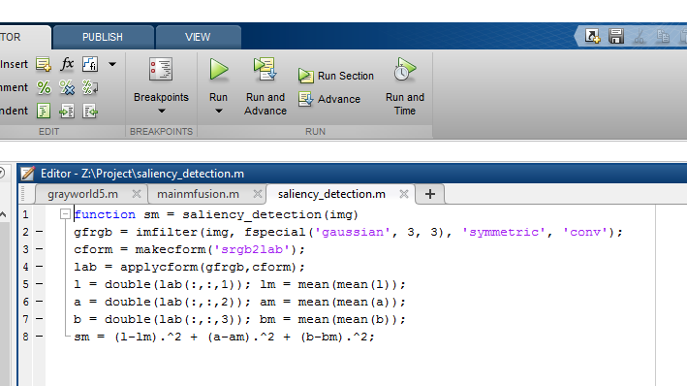
SALIENCY DETECTION

Slide 26
SATURATION WEIGHT
It enables the fusion algorithm to adapt to chromatic information by advantaging highly saturated regions.
SAT = 1/ e ^{((R-avg)^2/2* sigma^2)}

Slide 27
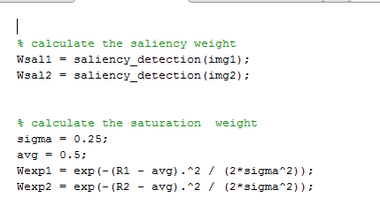
SATURATION WEIGHT

Slide 28
LAPLACIAN PYRAMID
A Laplacian pyramid saves the difference image of the blurred versions between each levels .only the smallest level is not a difference image to enable reconstruction of high resolution image using the difference images on high levels. This technique can be used for image compression.
b _{k} = I _{k} – E*I _{k-1}

Slide 29
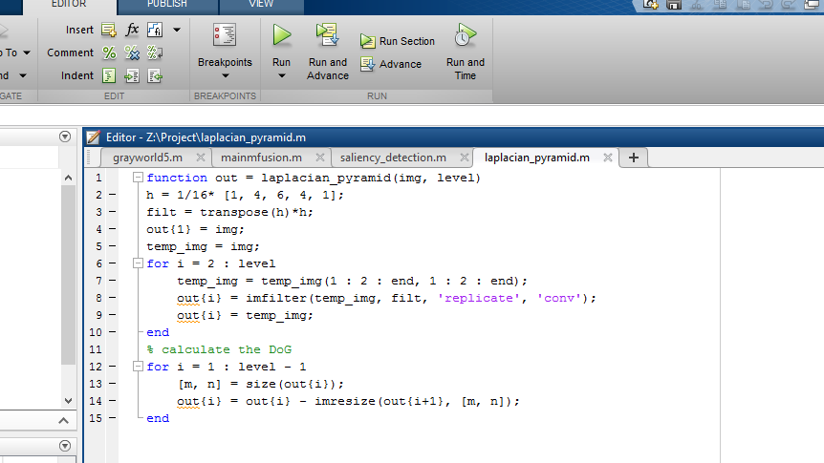
LAPLACIAN PYRAMID

Slide 30
GAUSSIAN PYRAMID
In a Gaussian Pyramid , subsequent images are weighted and scaled down. Each pixel containing a local average that corresponds to a pixel neighbourhood on a lower level of the pyramid.
b _{k} = I _{k} – EI _{k-1}

Slide 31
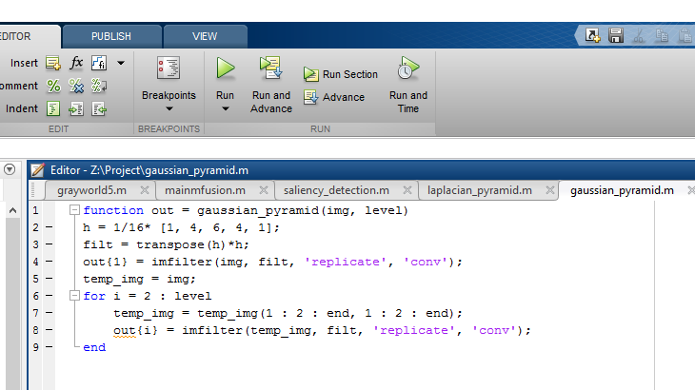
GAUSSIAN PYRAMID

Slide 32
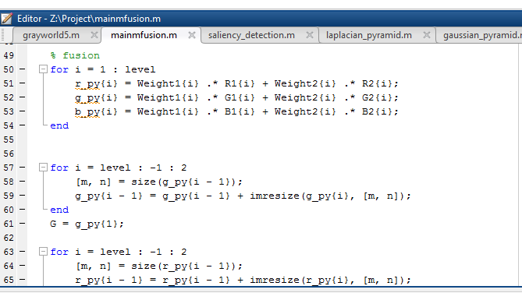
Multi-Scale fusion

Slide 33
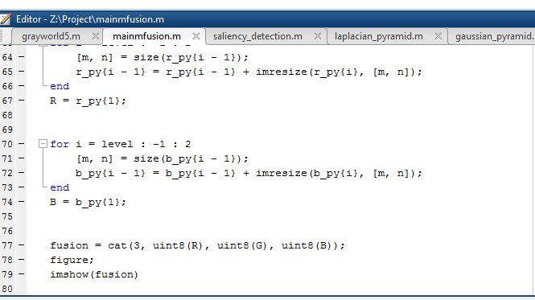
MULTI-SCALE FUSION

Slide 34
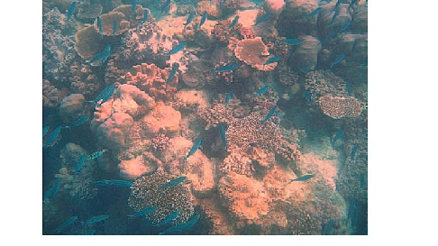
OUTPUT

Slide 35


